Slide 1






PolyChar 23
23rd World Forum on Advanced Materials
Lincoln, Nebraska, U.S.A.
May 11-15, 2015
Structure Gradients by Microfocus Synchrotron X-ray Diffraction
in Shell-Core Polyamide Microcapsules
Zlatan Z. Denchev¹, Nadya V. Dencheva¹, Stephan Roth²
⁽¹⁾ I3N – Institute for Polymers and Composites, University of Minho, Department of Polymer Engineering, Guimarães, Portugal
⁽²⁾ Photon Science at DESY, Notkestr. 85, Hamburg, Germany
e-mail: denchev@dep.uminho.pt

Slide 2

2
Outline:
Objectives
Samples: PA6@ payloads microcapsules, synthesis by in-situ polymerization
Structure of polyamide materials by X-ray diffraction:
- Conventional WAXS
- Synchtrotron WAXS
- Microfocus high-flyx synchrotron WAXS
Conclusions

Slide 3
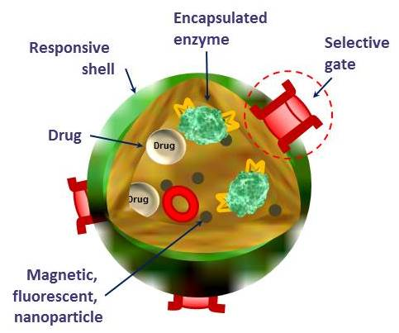
3
One-pot synthesis of PAMC
Starting mixture
Viscous particles
Microcapsules
Monomer
Catalytic system
Payload
Solvent
Multifaceted applications
CM, IM
Functionalization & Conjugation
Pay-loads used (1-10 wt.%):
Natural nano-clays, Synthetic Al/Ti sillicates
Carbon allotropes – CB, CNT, CNF, Fullerenes
Metal & Metal oxides – Cu, Al, Mg, Fe, Fe₃O₄
PAMC
Hybrid composite materials
with electro-conductive & magnetic properties
Smart multifunctional
particle

Slide 4
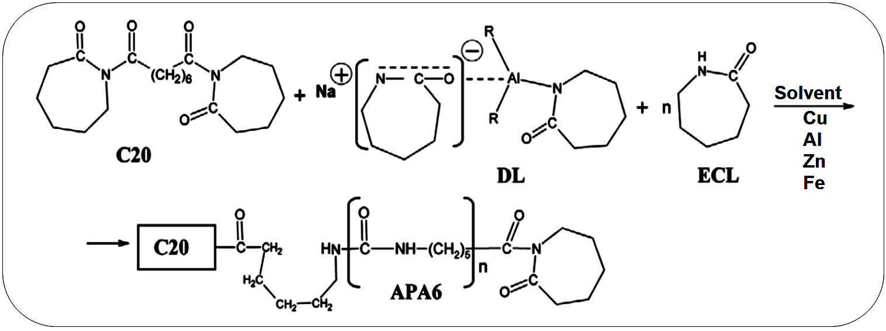
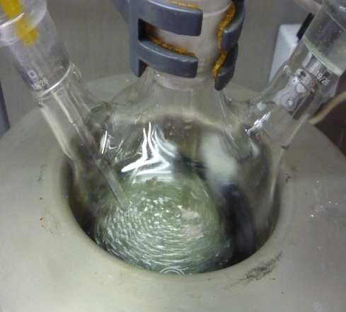
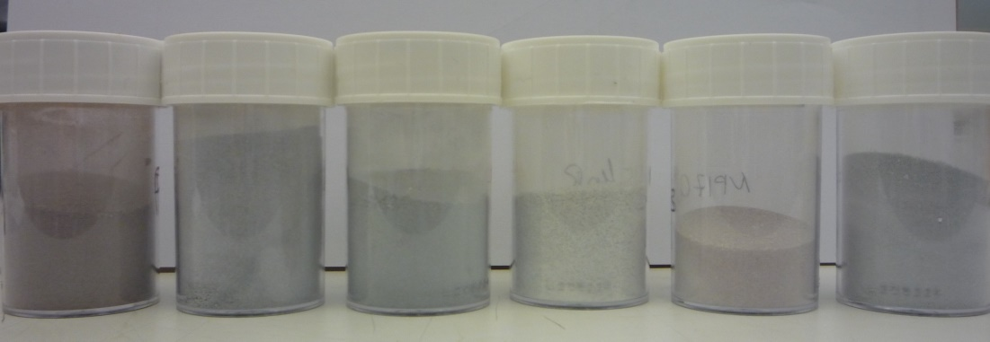
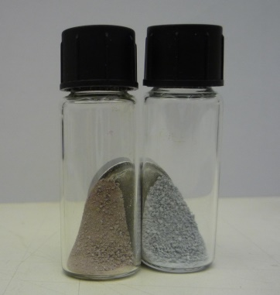
4
One-pot synthesis of PAMC – reaction
Pay-loads used (1-10 wt.%):
Natural nano-clays (CLOISITE 15A, CLOISITE 20A );
Synthetic Al/Ti sillicates
Carbon allotropes – CB, CNT, CNF, Fullerenes
Metal & Metal oxides – Cu, Al, Mg, Fe, Fe₃O₄
Pat. Appl. 12345/2015

Slide 5
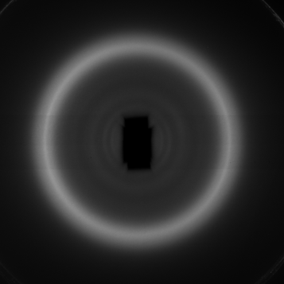
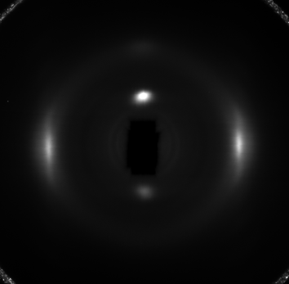
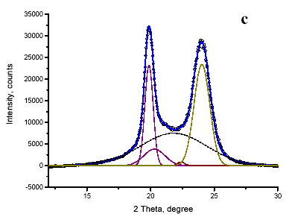
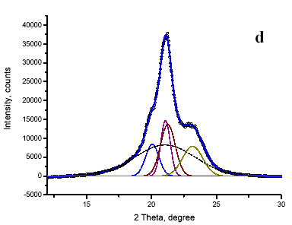
5
Standard X-ray diffraction - PA6
Isotropic PA6
Oriented PA6
Predominantly α crystalline form
Predominantly γ crystalline form

Slide 6
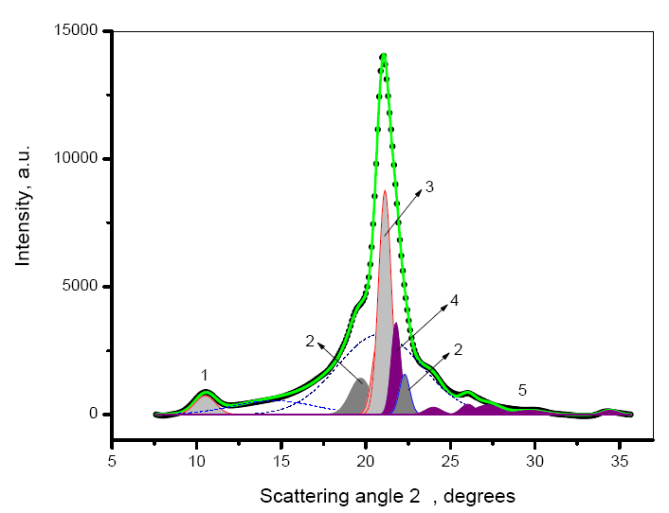
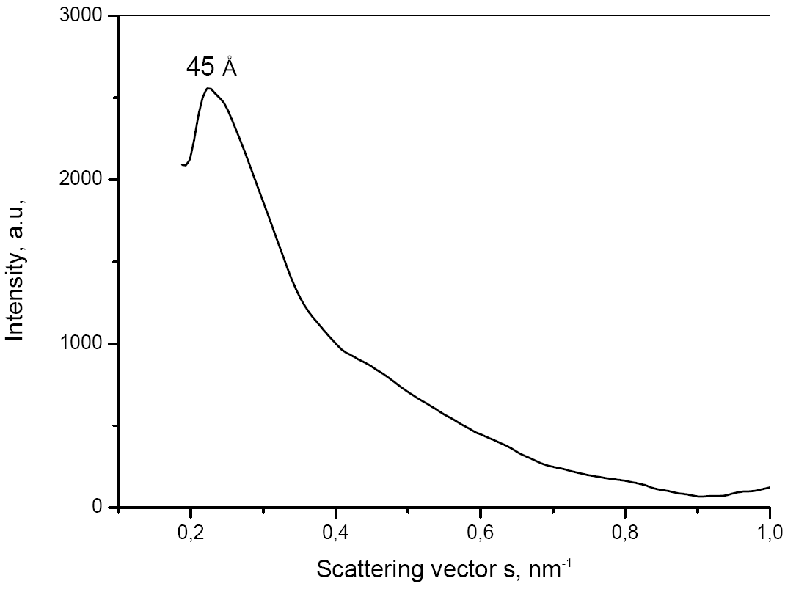
6
Standard X-ray diffraction - loads
Pure nanoclays: NM @CL15A
PA6 / 7.5 wt.% NM
‘
2Θ,
1 – (020) reflection of γ-PA6;
2 – (200); 2’ - (002/202) reflection of the α-PA6;
3 – (200) reflection of the γ-PA6;
4 – Opal CT reflection of NM;
5 – weaker reflections of the NM phase.
The inset shows the WAXS curve in the 0.1-1.0 nm⁻¹ range of the scattering vector s.

Slide 7
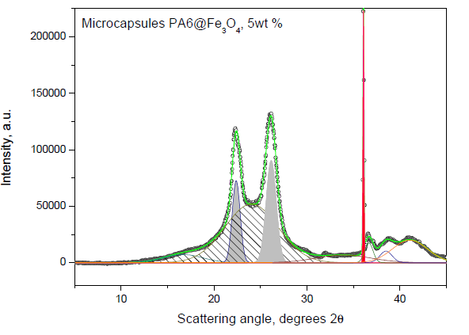
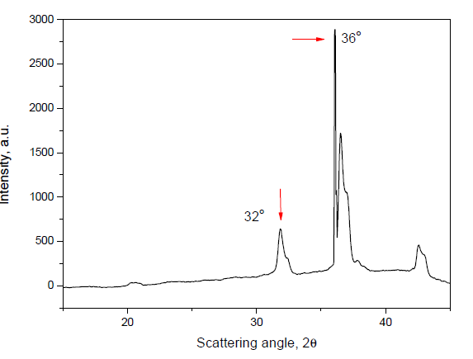
7
Standard X-ray diffraction
PA6/ 5 wt.% of Fe, Al….
Me
1 – (200); 2’ - (002/202) reflection of the α-PA6;
2 – The strongest reflection of Fe3O4

Slide 8
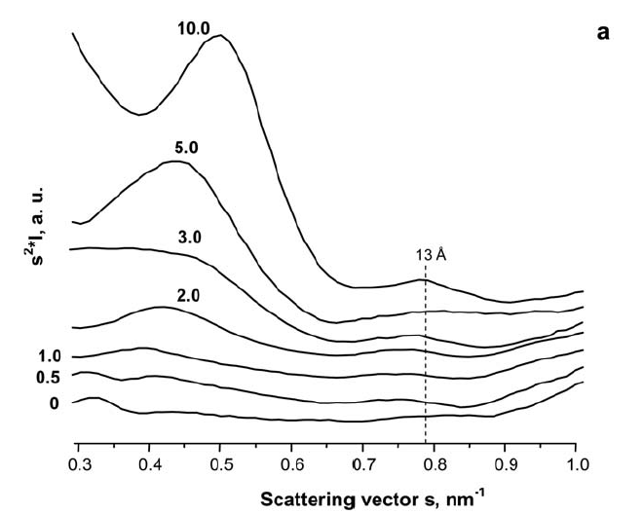
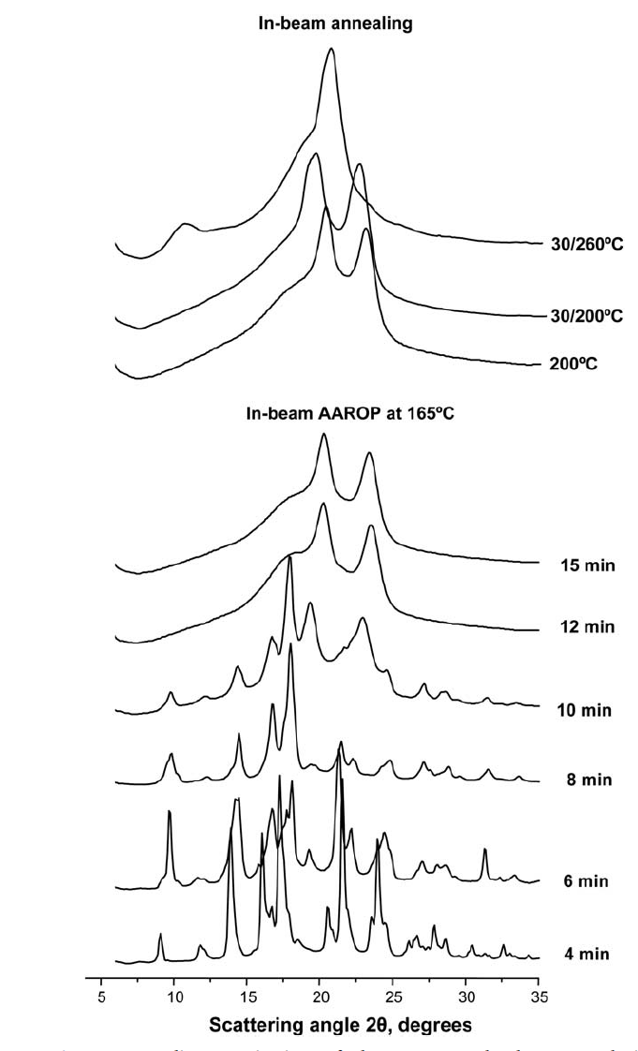
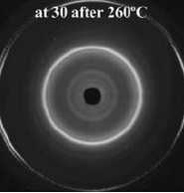
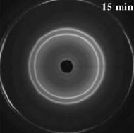
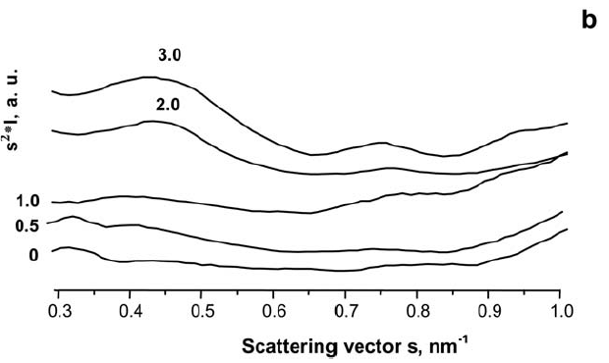
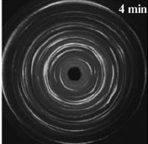
8
Synchrotron X-ray diffraction
Cloisite 15 A 2 wt%
v
v
PA6 @ Cloisite 15ª, various %

Slide 9
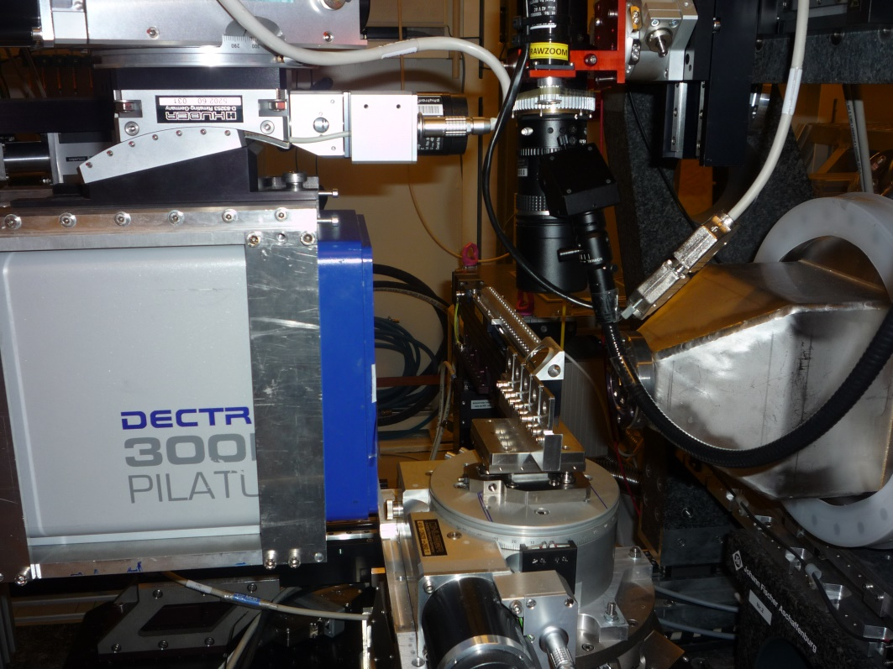
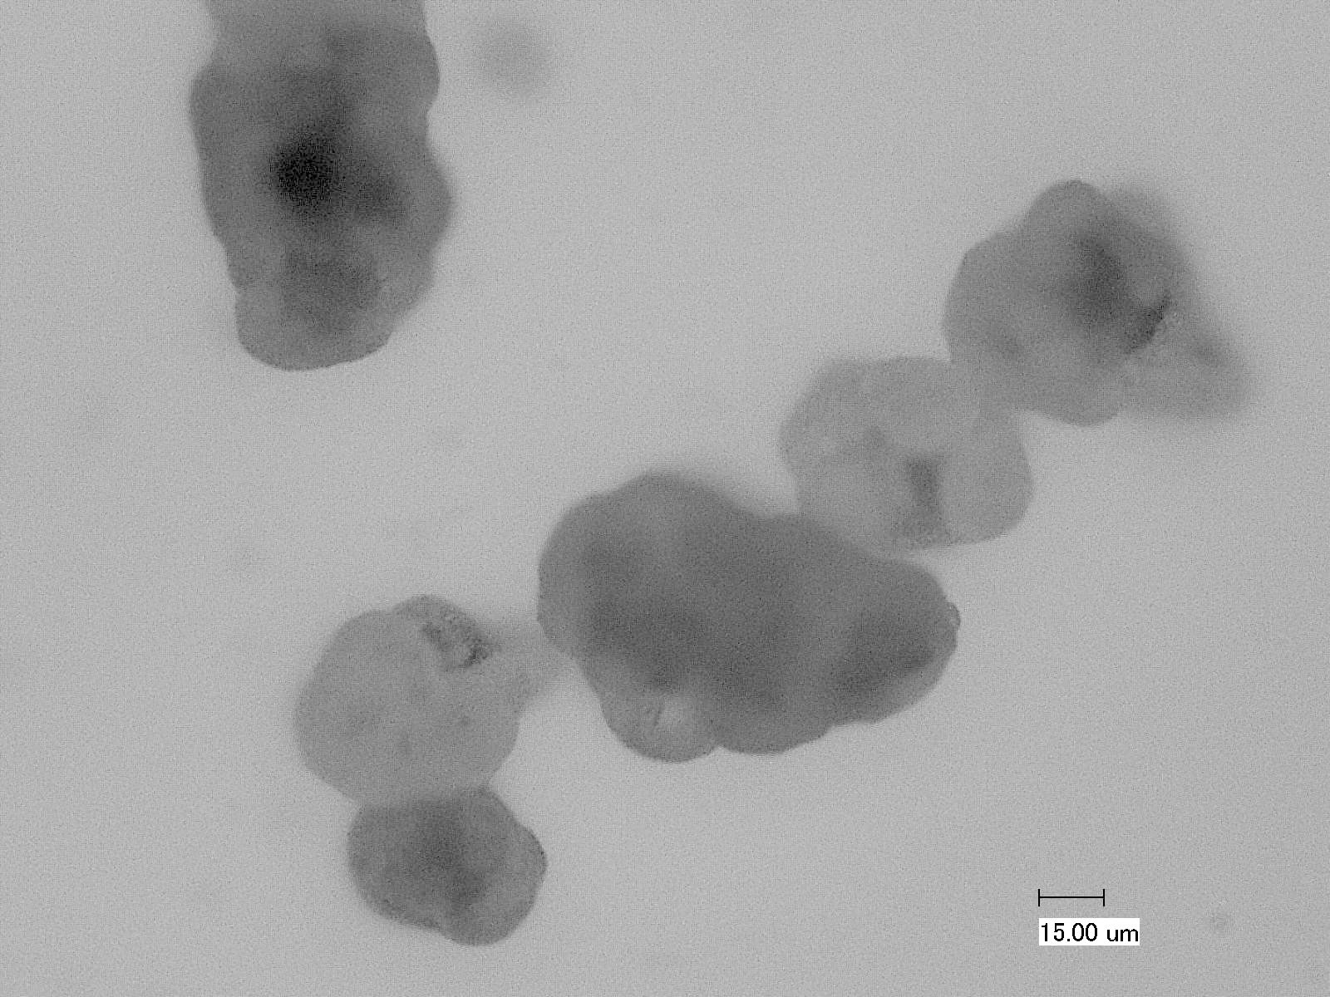

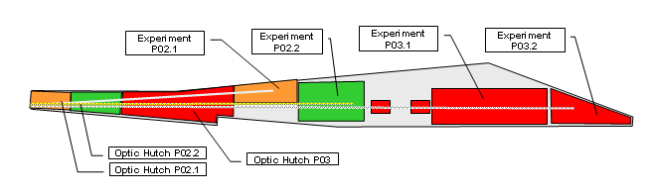
9
High-flux microfocus beam synchrotrons
P03 microfocus beamline

Slide 10
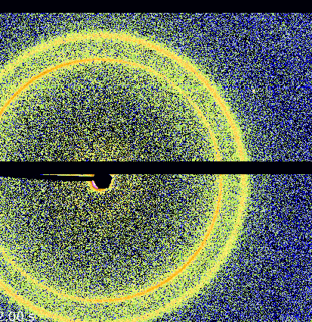
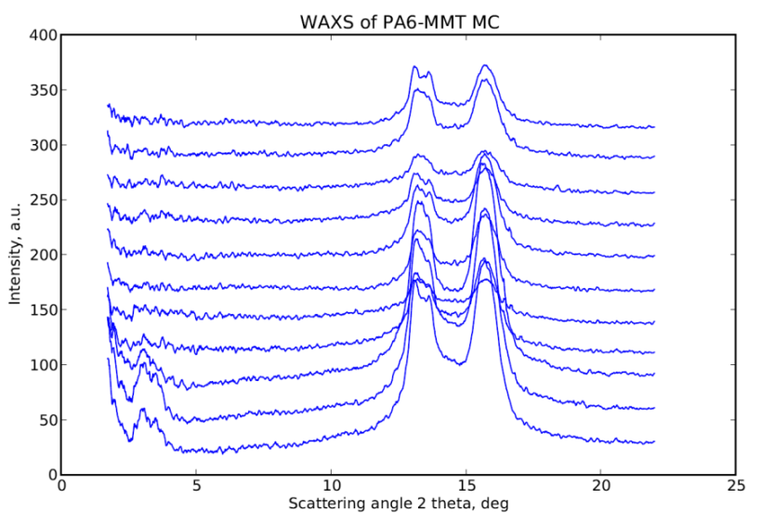
10
Microfocus High-flux Synchrotron WAXS
Y1; X 1
Y3; X 1-11
5/5μm
Scanning along X

Slide 11
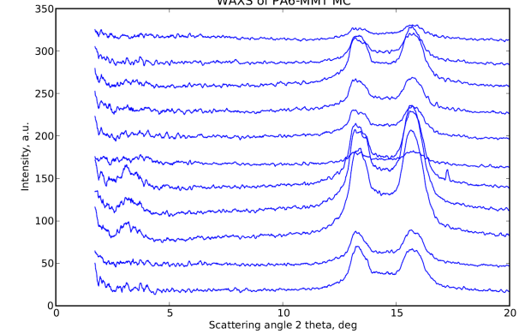
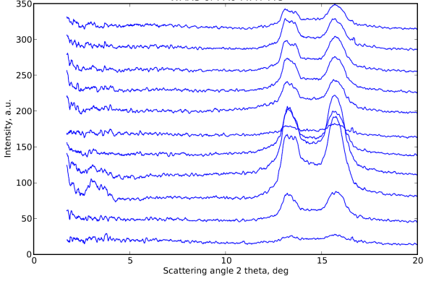
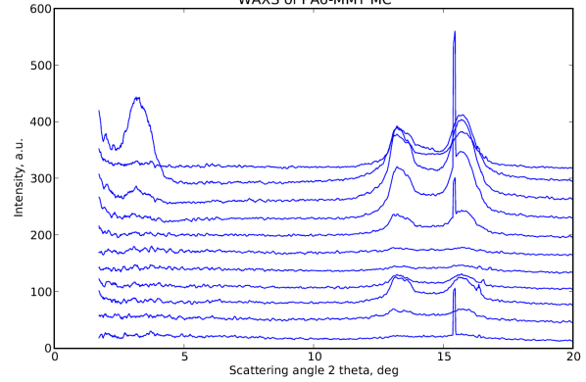
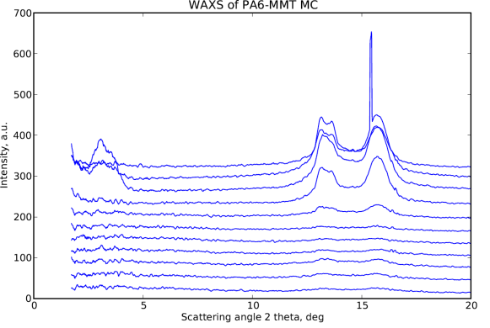
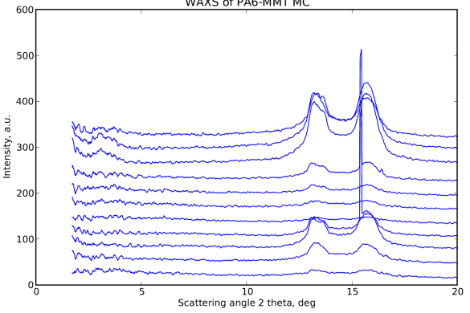
11
Microfocus High-flux Synchrotron WAXS
x11
Scanning along Y
Y11; X1-10
y11
x01
Y10; X1-10
y01
Y09; X1-10
Y08; X1-10
Y07; X1-10

Slide 12
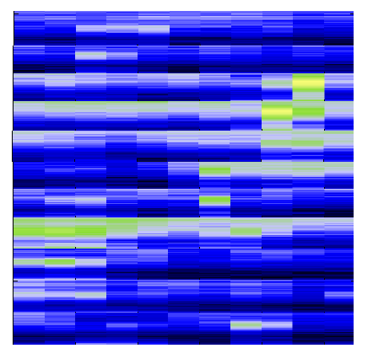

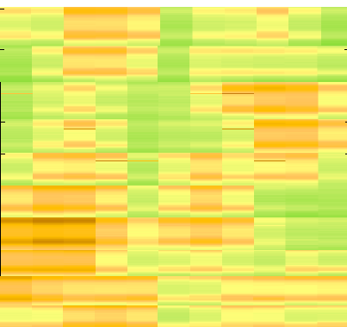
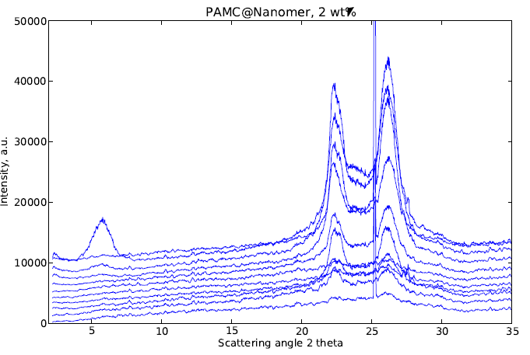
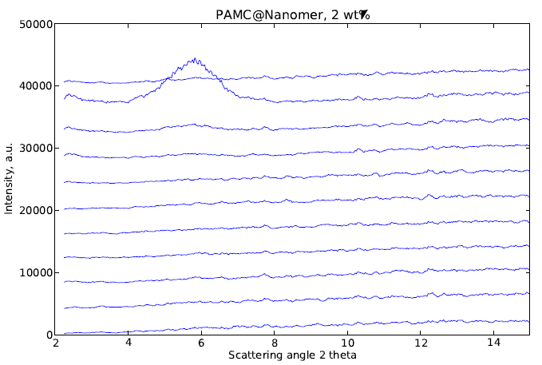
12
Microfocus High-flux Synchrotron WAXS
Distribution of non-exfolliated MMT
Thickness distribution of the PAMC layer
PAMC@Nanomer 2 wt%
Non-homogeneous exfoliation of MMT

Slide 13
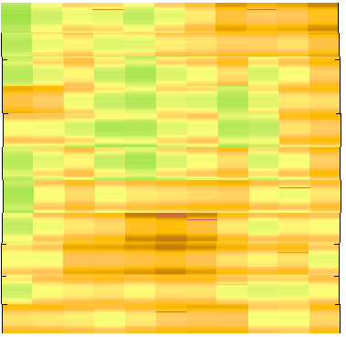
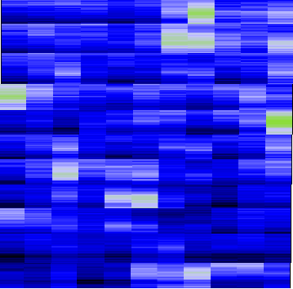

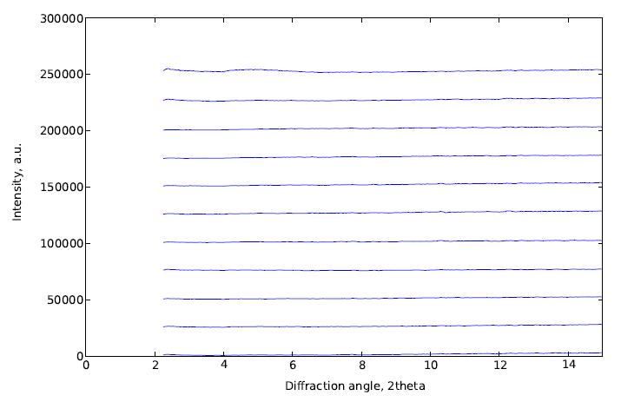
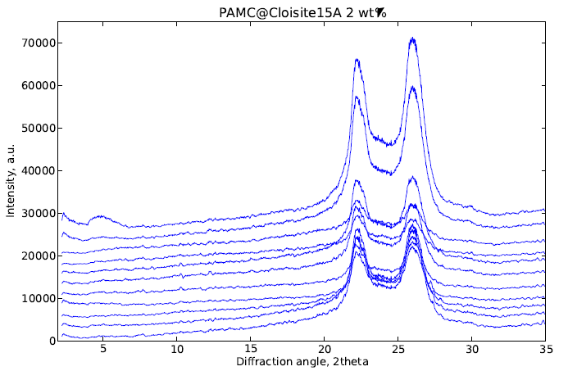
13
Microfocus High-flux Synchrotron WAXS
Distribution of non-exfolliated MMT
Thickness distribution of the PAMC layer
PAMC@Cloisite 15A 2 wt%
Relatively homogeneous exfoliation of MMT

Slide 14
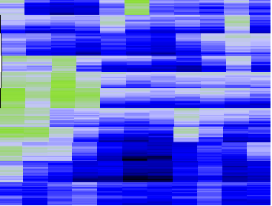
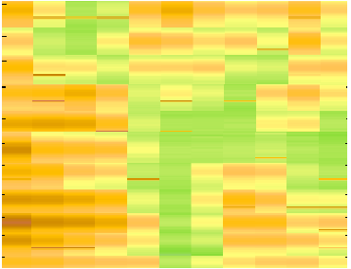

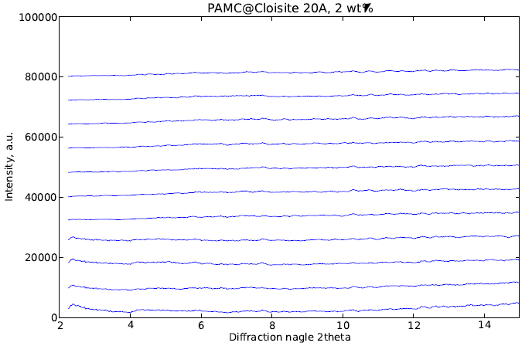
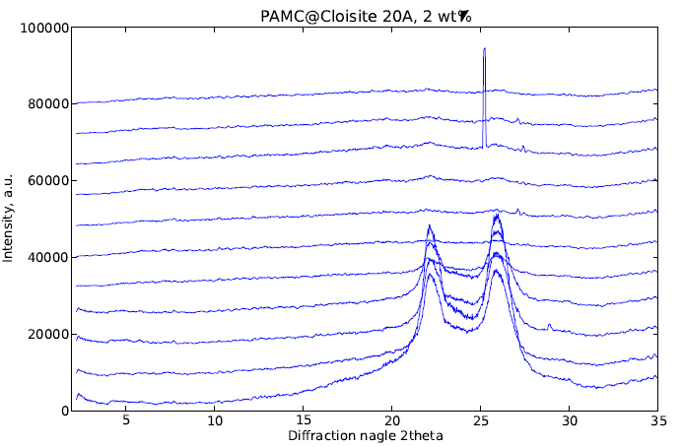
14
Microfocus High-flux Synchrotron WAXS
Distribution of non-exfolliated MMT
Thickness distribution of the PAMC layer
PAMC@Cloisite20A 2 wt%
Homogeneous MMT distribution

Slide 15
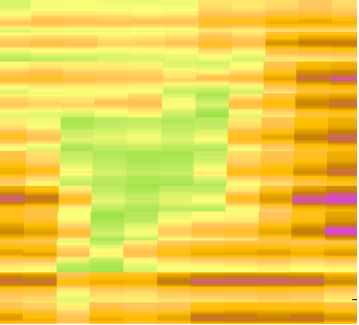
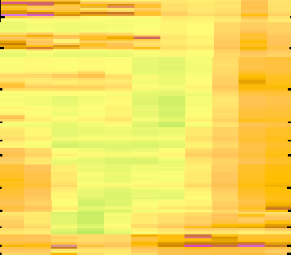
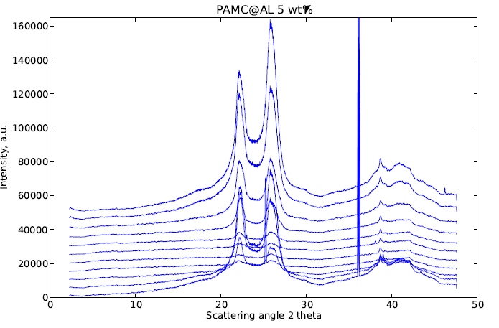
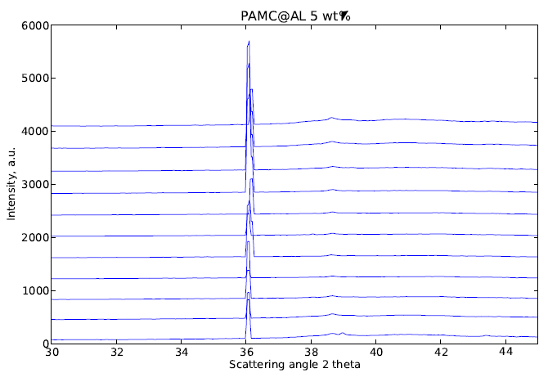
15
Microfocus High-flux Synchrotron WAXS
Thickness of PA6 layer
Intensity of the Al reflection
PAMC@Al 5 wt%
PA6-covered metal platelets

Slide 16
16
Conclusions
High flux microfocus WAXS can determine microgradients in very fine layers of pulverulent composite materials;
2. Relatively simple setups and data processing algorithms permit visualization of both layer thickness and load distribution in areas starting from 5x5 µ²;
3. Studying different scattering angle areas gives information about the filler size, distribution, matrix amount and polymorphism;
4. Further development of the technique proposed will be the use of nanosized high-flux synchrotron beams.

Slide 17


17
Acknowledgements
1. n-STEP – 07-0124-FEDER-00039 supported by the Programa Operacional Regional do Norte ON-2;
2. FEDER fund through the COMPETE-2020 Program and National Funds through FCT under the project UID/CTM/50025/2013;
3. DESY Photon Science Project No I-20130095 EC

