Slide 1
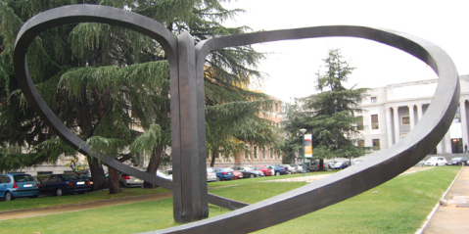




Synchrotron Radiation in Polymer Science
Madrid, 2015
Nanostructure Development in Multicomponent Polymer Systems and Its Characterization by Synchrotron X-ray Scattering
Z. Denchev, N. Dencheva
Institute for Polymers and Composites/I3N Associated Laboratory, University of Minho, Portugal
A. Stribeck
Institute of Technical and Macromolecular Chemistry, University of Hamburg, Germany
S. Roth
Photon Science at DESY, Hamburg, Germany
E-mail: denchev@dep.uminho.pt

Slide 2


2
Outline
Motivation and Goals
In-situ Microfibrilar Composites
Preparation and morphology
Static transcrystallinity characterization by WAXS
Fine crystalline stcruture by SAXS under strain
Polyamide 6 Micorcapsules containing Solid Materials
Preparation and morphology
Crystalline strcuture via microfocus WAXS
Conclusions

Slide 3
3
Microfibrilar Composites - Preparation
Fibrilation
TCL formation
Polymer 1 = PA6 (may contain up to 7.5% MMT, Cloisite® or Nanomer®)
= PA12
Polymer 2 = HDPE
Compatibilizer = YP (HDPE-MAH)

Slide 4
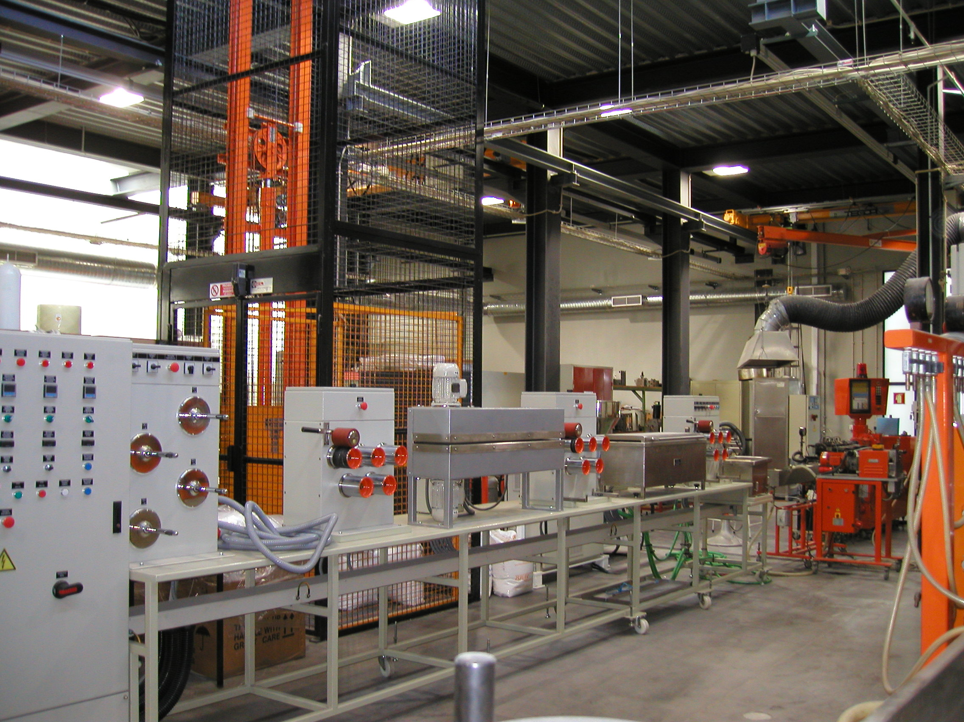
4
MFC Preparation
λ
= 2.6
λ
2
= 6.3
1
Oriented
cable
Cooling
Haul
-
Heating
Haul
Winder
Extruder
-
Bath 1
off 1
Bath 2
off 2
HDPE | PA6 | PA12 | YP
65 |  | 30 | 5
70 |  | 20 | 10
75 |  | 20 | 5
77.5 |  | 20 | 2.5
80 |  | 20 | 0
65 | 30 |  | 5
70 | 20 |  | 10
75 | 20 |  | 5
77.5 | 20 |  | 2.5
80 | 20 |  | 0
 | wt-% |  | wt-% Clay in PA6 |  | Pre-blended with extra PA6
HDPE | PA6 | YP | Nanomer | Cloisite
80 | 20 |  | 1.0 - 7.5 |  | yes
77.5 | 20 | 5 | 1.0 - 7.5 |  | yes
80 | 20 |  |  | 1 - 5 | yes
80 | 20 |  |  | 1 - 5 | no
77.5 | 20 | 5 |  | 1 - 5 | yes
77.5 | 20 | 5 |  | 1 - 5 | no

Slide 5
5
MFC – Mechanical Properties
TENSILE PROPERTIES HDPE/PA6/YP
TENSILE PROPERTIES HDPE/PA12/YP
70
1 - 90/10/0
70
2
2
2 - 80/20/0
1-
90/10/0
60
3 - 70/20/10
60
4
3
2-
80/20/0
6
4 - 75/20/5
3-
70/20/10
5 - 7.5/20/2.5
50
4-
75/20/5
50
5
5
5-
77.5/20/2.5
6 - 65/30/5
6-
65/30/5
40
4
40
Stress, MPa
3
6
HDPE
30
HDPE matrix
Stress, MPa
1
1
30
20
20
10
10
0
0
20
40
60
80
100
600
800
0
Strain, %
0
10
20
30
40
50
60
600
800
Strain, %
TENSILE PROPERTIES HDPE/PA6/YP/MMT

Slide 6
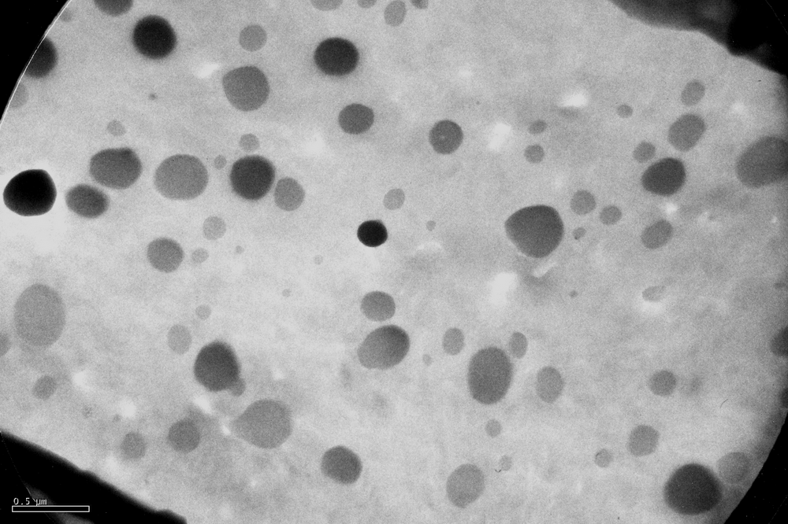
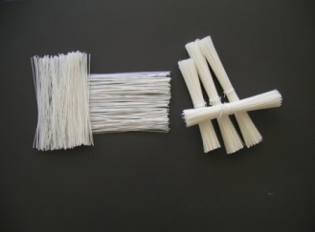
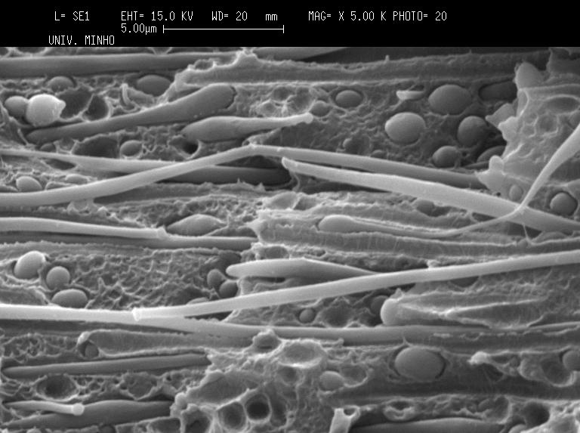
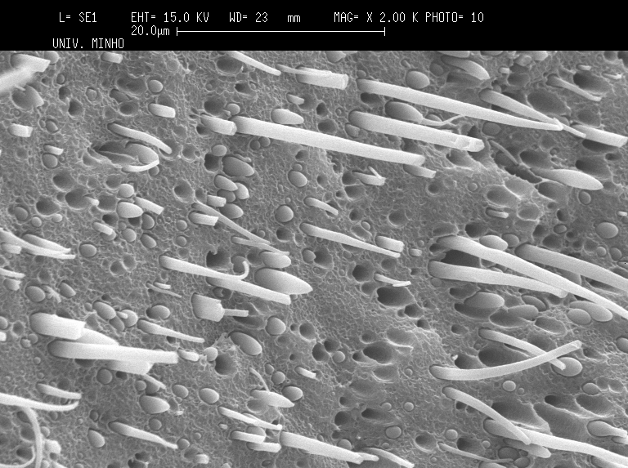
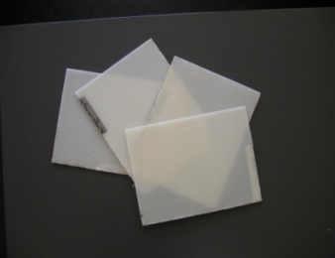
6
MFC – Morphology by SEM
Fibril Ǿ = 100-400 nm
500 nm
OP 80/20/0
Fibril Ǿ = 500-800 nm
5 μm
Fibril Ǿ = 1500-1800 nm
20 μm
UDP MFC 80/20/0
UDP MFC 80/20/0 + 5 % MMT

Slide 7
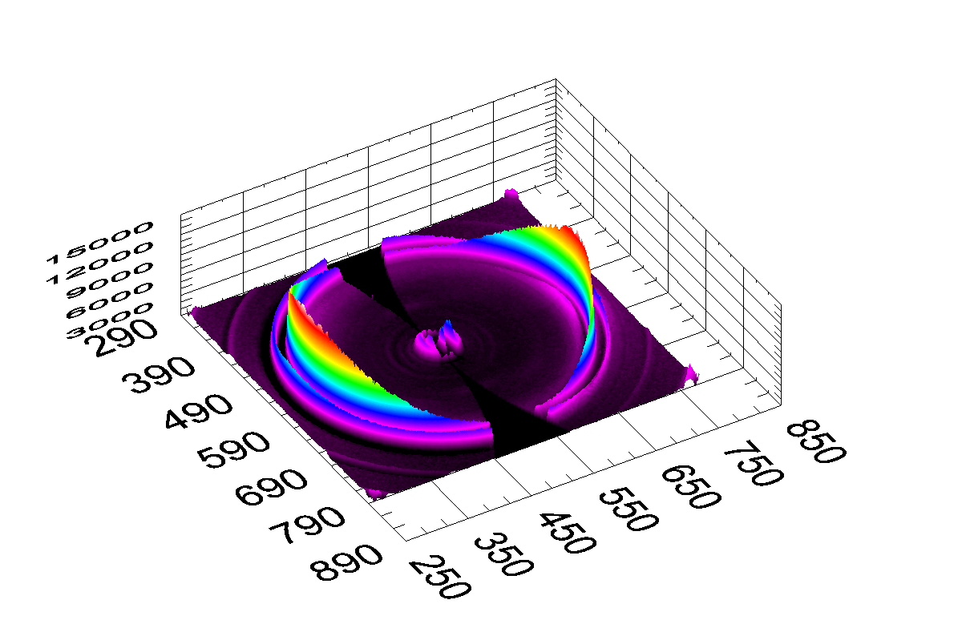
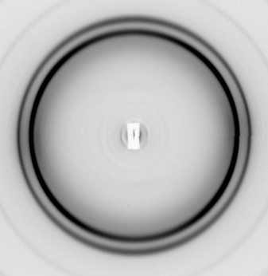
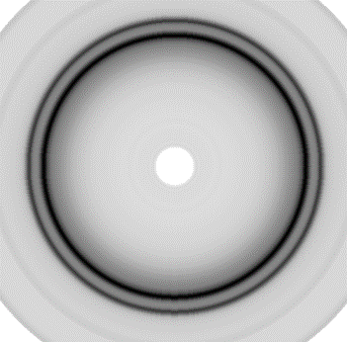
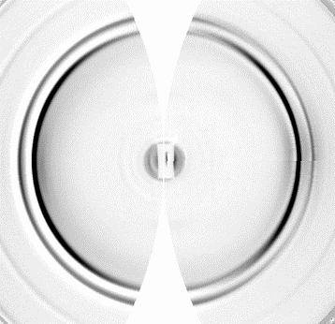
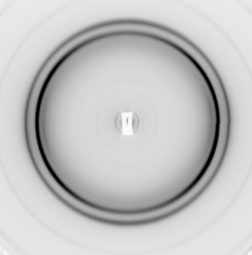
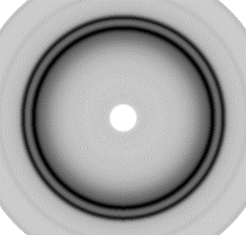
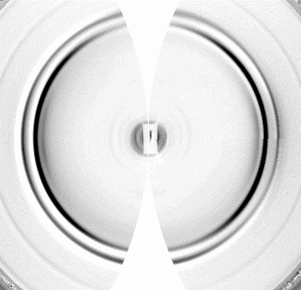
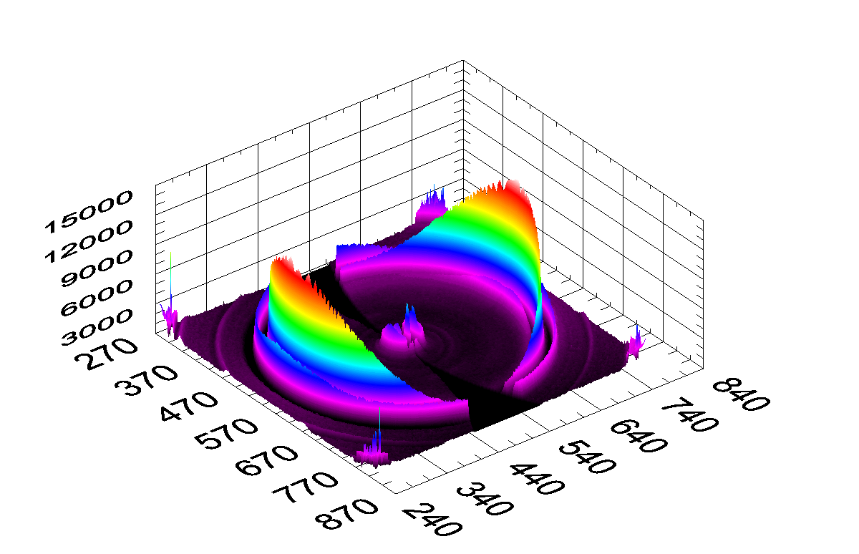
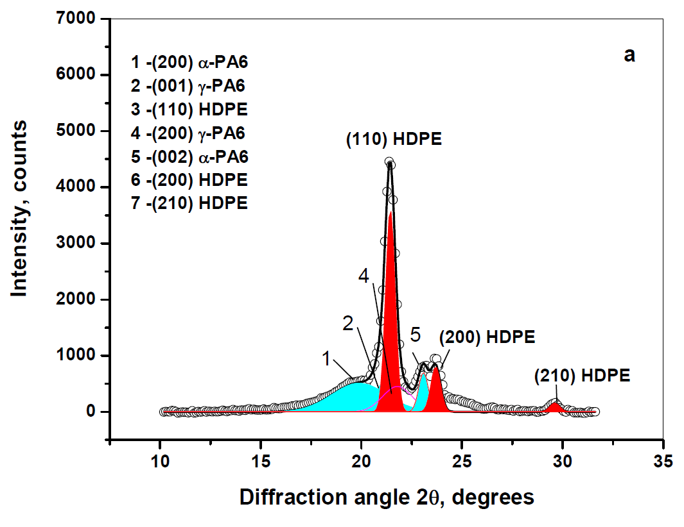
7
MFC – synchrotron WAXS (DORIS, A2-beamlne)
POLAR -- Stonybrook Technology and Applied Research Inc.
Initial pattern
Isotropic scattering
Oriented scattering
HDPE/PA6/YP
80/20/0
-
=
70/20/10
-
=
1D WAXS –peak fitting
1D WAXS
Oriented scattering
(110) HDPE
(200) HDPE
(200) α PA6
HDPE/PA6/YP
PA6, %
HDPE, %
PA6/HDPE
80/20/0
55.7
44.3
1.257
70/20/10
50.8
49.2
1.032

Slide 8
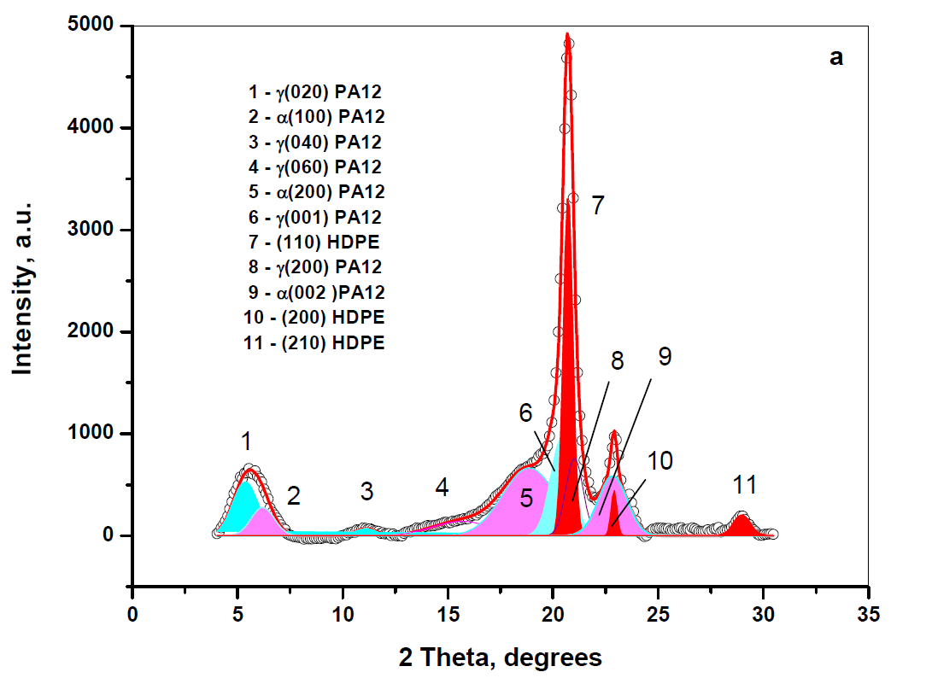
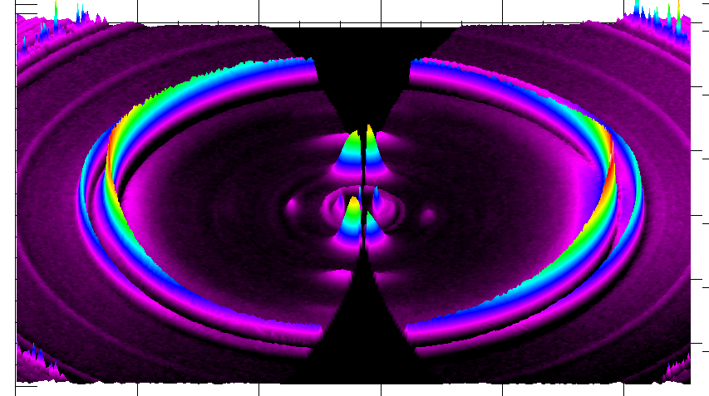
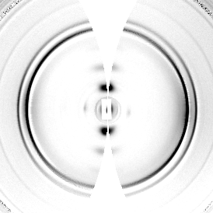
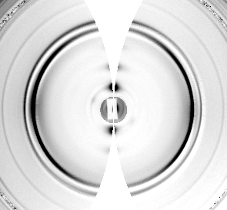
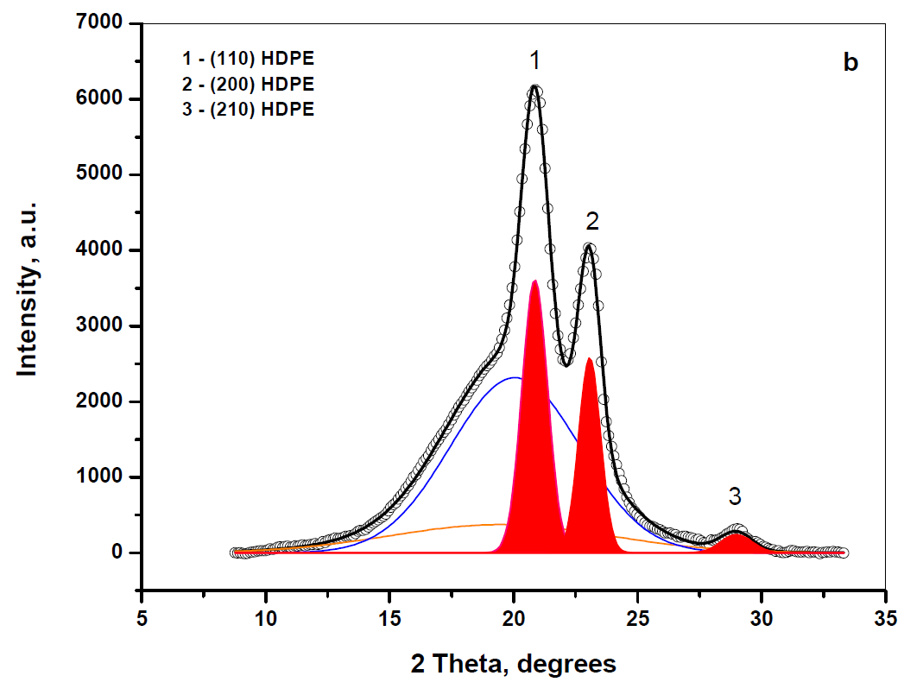
8
MFC – synchrotron WAXS
2D WAXS oriented
Oriented scattering
80/20/0
(110) HDPE
(200) HDPE
(020) γ PA12
(040) γ PA12
70/20/10
1D WAXS
Oriented scattering
Isotropic scattering
HDPE/PA12/YP
PA12, %
HDPE, %
f
90/10/0
65.3
34.7
1.911
80/20/0
73.8
26.2
2.817
70/20/10
66.0
34.0
1.941
75/20/5
67.4
32.6
2.067
77.5/20/2.5
68.9
31.1
2.215
65/30/5
71.1
28.9
2.460
f = PA12/HDPE

Slide 9
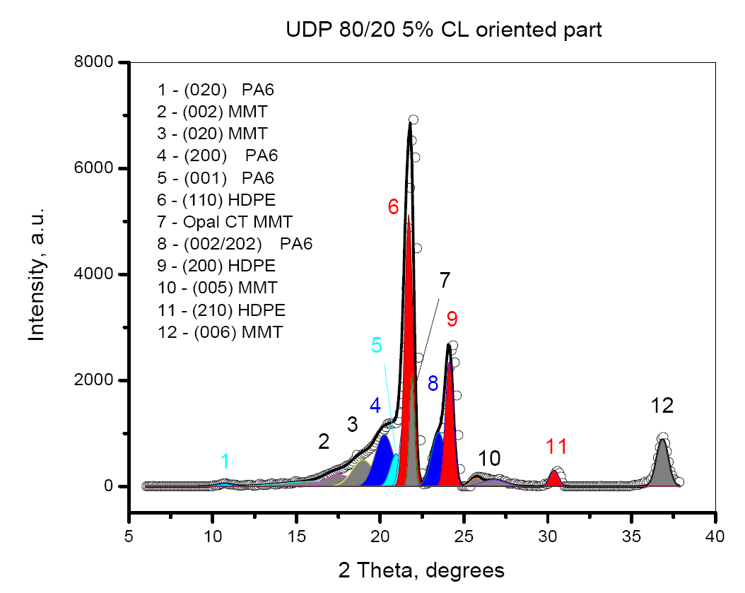
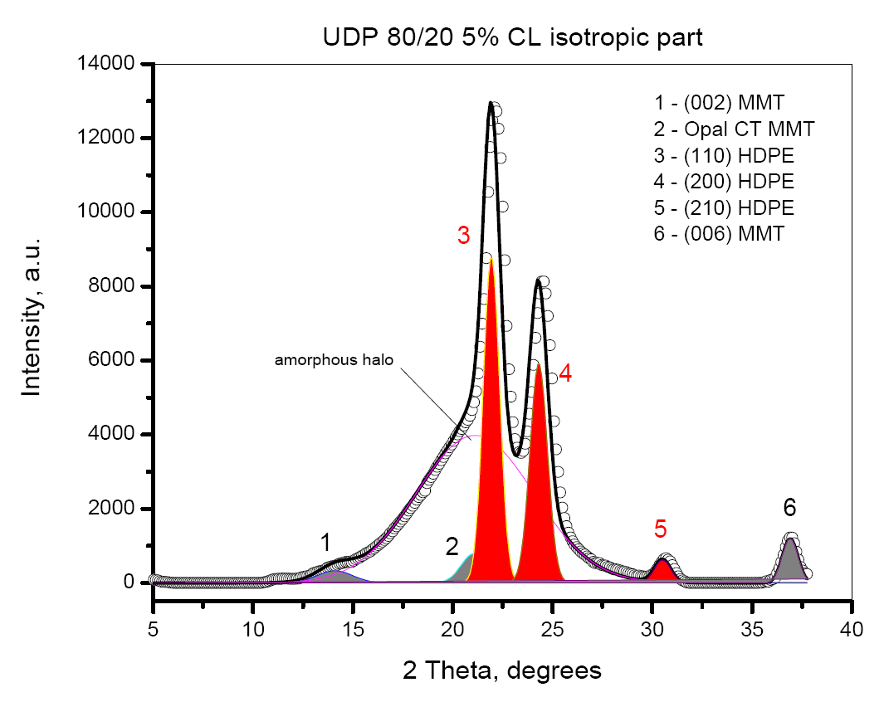
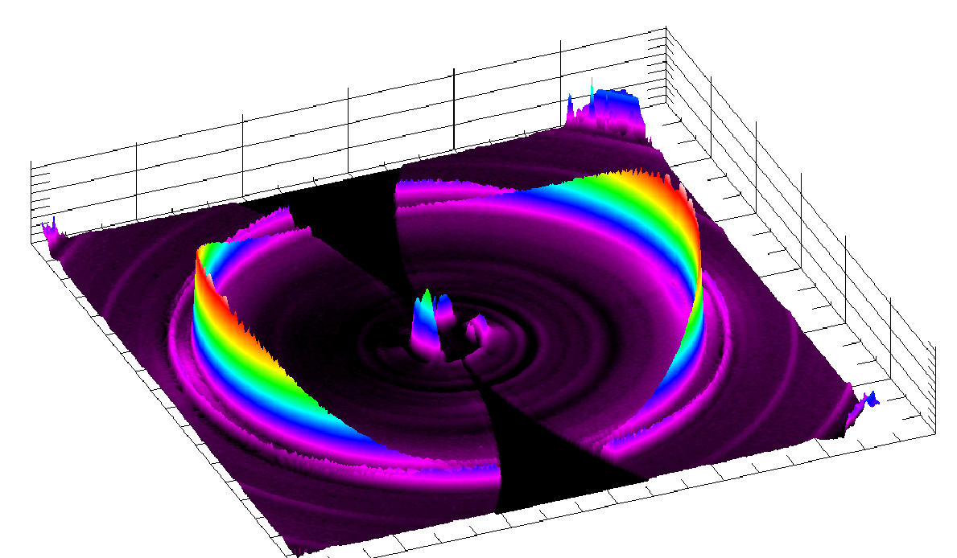
2
Outline
1. MMT is present in both oriented and
isotropic scattering;
2. The isotropic part does not contain PA6.
HDPE/PA6/YP/MMT | PA6, % | HDPE, % | f
80/20/0/4 NM | 37.6 | 37.3 | 1.00
80/20/0/4 CL | 30.8 | 35.3 | 0.87
80/20/0/5 NM | 33.8 | 32.1 | 1.05
80/20/0/5 CL | 31.7 | 39.0 | 0.81
80/20/0/7.5 NM | 32.6 | 27.9 | 1.17
77.5/20/2.5/ 5 NM | 32.3 | 29.0 | 1.11

Slide 10
10
MFC – Comparative Structure Studies by WAXS
Components of the WAXS
oriented scattering
2R₁
2R₂
TCL = R₂ – R₁
PA6, %
HDPE, %
HDPE/PA6/YP
f
2R₁ = ?
80/20/0
55.7
44.3
1.26: 1
L
70/20/10
50.8
49.2
1.03 : 1
HDPE/PA12/YP
PA12, %
HDPE, %
f
90/10/0
65.3
34.7
1.911
80/20/0
73.8
26.2
2.817
70/20/10
66.0
34.0
1.941
75/20/5
67.4
32.6
2.067
77.5/20/2.5
68.9
31.1
2.215
65/30/5
71.1
28.9
2.460
HDPE/PA6/YP/MMT | PA6, % | HDPE, % | f
80/20/0/4 NM | 37.6 | 37.3 | 1.00
80/20/0/4 CL | 30.8 | 35.3 | 0.87
80/20/0/5 NM | 33.8 | 32.1 | 1.05
80/20/0/5 CL | 31.7 | 39.0 | 0.81
80/20/0/7.5 NM | 32.6 | 27.9 | 1.17
77.5/20/2.5/ 5 NM | 32.3 | 29.0 | 1.11
Macromolecules 43:4715 (2010)
10

Slide 11
11
MFC – Comparative Structure Studies by WAXS
HDPE/PA6/YP, no MMT
HDPE/PA6/YP, with MMT
UDP MFC 80/20/0/ 5% NM
UDP MFC 80/20/0/ 5% CL
UDP MFC 80/20/0
UDP MFC 70/20/10
2R₂ = 1050 nm
2R₂ = 1320 nm
2R₂ = 750 nm
2R₂ = 500 nm
2R₁ = 550 nm
2R₁ = 738 nm
2R₁ = 350
TCL = 156 nm
TCL = 100 nm
TCL = 75 nm
2R₁ = 864 nm
UDP MFC 80/20/0/ 7.5% NM
TCL = 228 nm
HDPE/PA12/YP, no MMT
2R₂ = 1750 nm
UDP MFC 80/20/0
UDP MFC 70/20/10
UDP MFC 77.5/20/2.5 7.5 NM
2R₂ = 625 nm
2R₂ = 560 nm
2R₂ = 1200 nm
2R₁ = 539 nm
2R₁ = 457 nm
TCL = 43 nm
TCL = 52 nm
2R₁ = 1260 nm
2R₁ = 854 nm
11
TCL = 245 nm
TCL = 173 nm

Slide 12
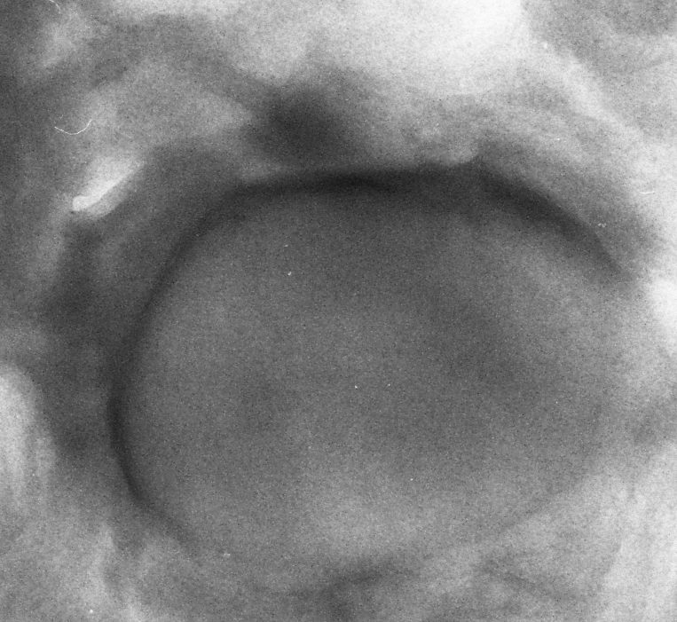
12
MFC – TEM and WAXS data comparison
HDPE/PA6/YP, no MMT
(model)
HDPE/PA6/YP, no MMT
(TEM image)
UDP MFC 80/20/0
2R₂ = 750 nm
2R₁ = 550 nm
2R₁ = 550 nm
TCL = 100 nm
ca. 520 nm
ca. 90 nm

Slide 13
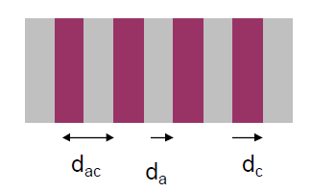

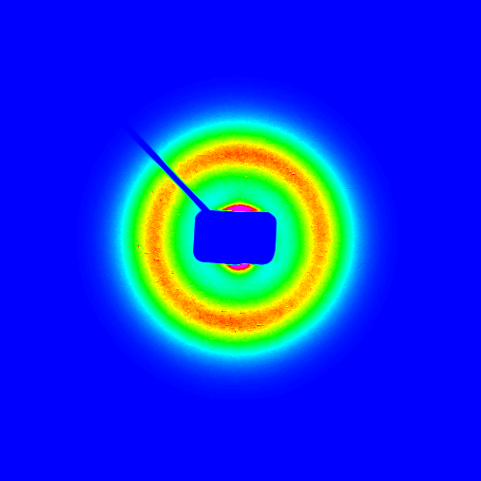
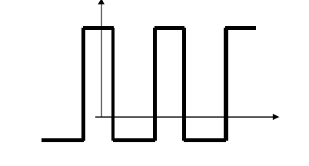
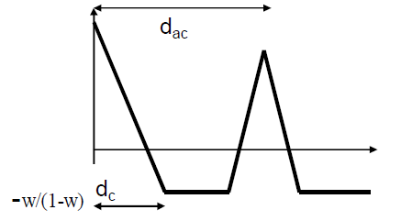
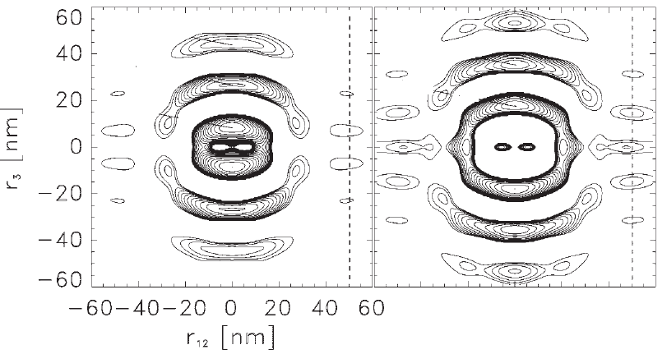
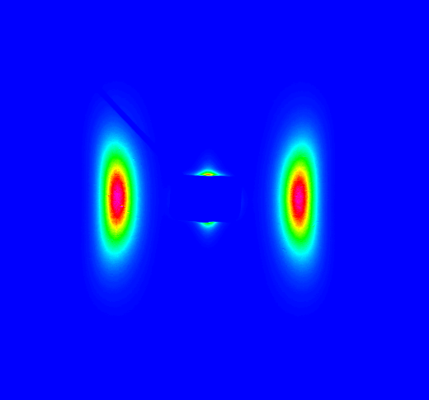
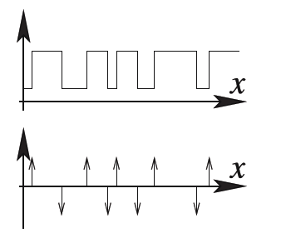



13
SAXS with 2D Detection – Outputs
Isotropic
1000
$${d_{ac}=L}_{B}=\frac{1}{s_{max}}$$
500
Intensity, a.u.
0
0.00
0.05
0.10
-1
0.15
0.20
s, nm
/Q
Raw SAXS curve
γ
+CDF
-CDF
Oriented
0
50
100
150
200
250
300
Distance
1D Correlation Function
$$ρ_{x}^{}$$
g/Q
$${ρ´}_{x}^{}$$
3D Chord Distribution Function
Stribeck, 2001
0
50
100
150
200
250
300
Distance, angstr.
Interface Distribution Function

Slide 14
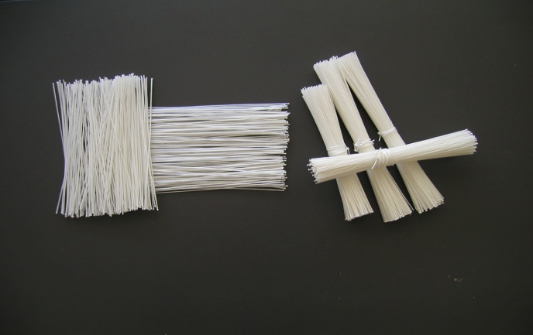
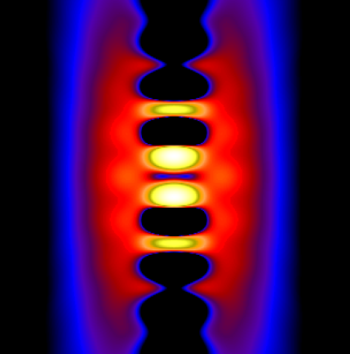
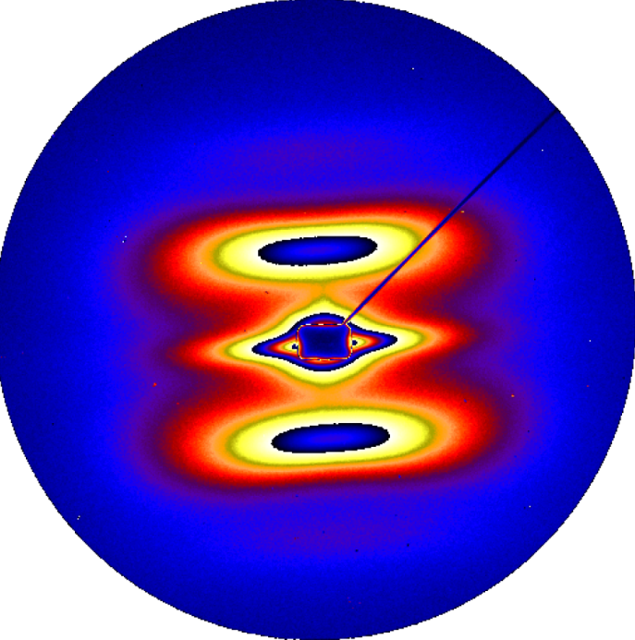
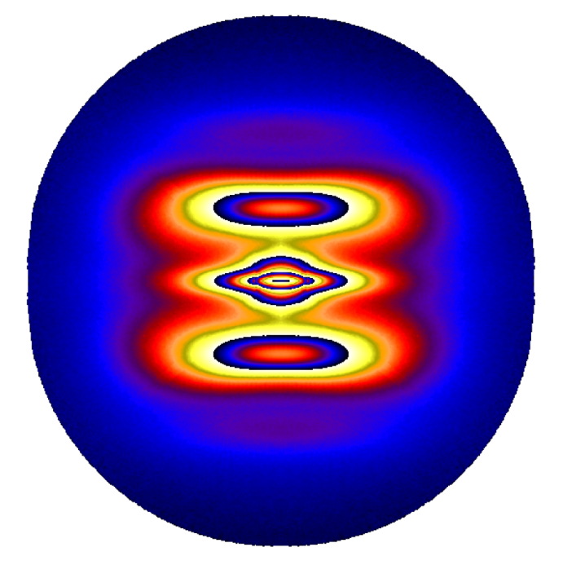
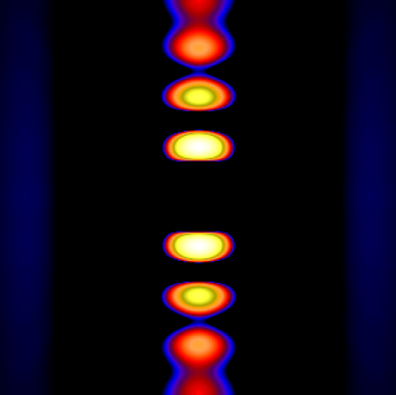
14
2D SAXS Data Treatment - CDF
Real Space
+
Reciprocal Space
-
Raw SAXS image
1. Background correction;
2. Calibration; 3. Reconstruction
4. Calculation of the positive and negative parts of the CDF
pv Wave® – 4GL Programming Environment

Slide 15
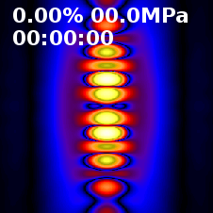
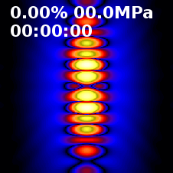
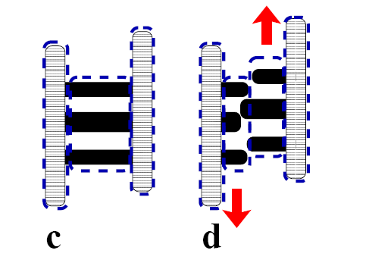
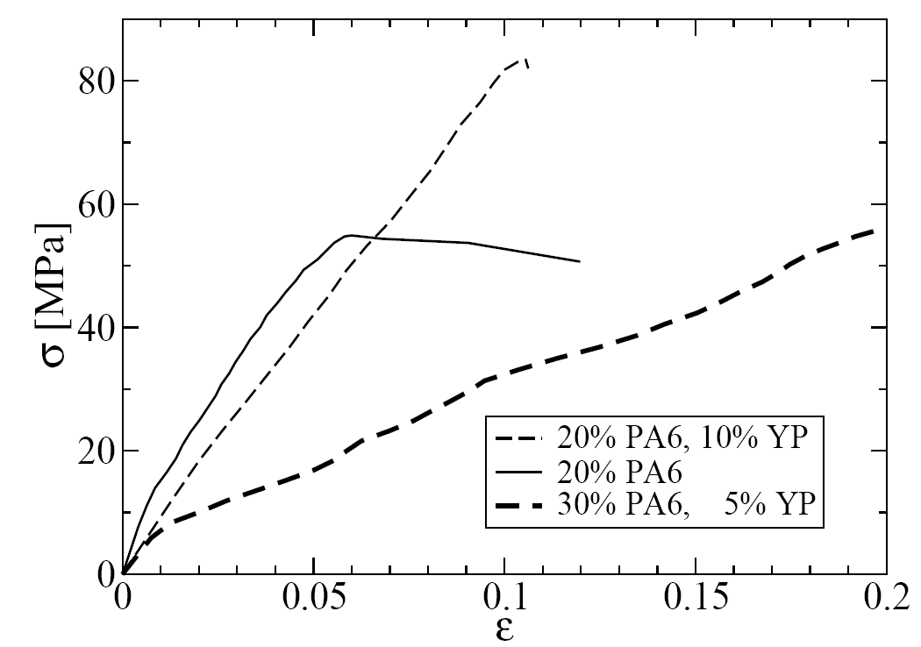
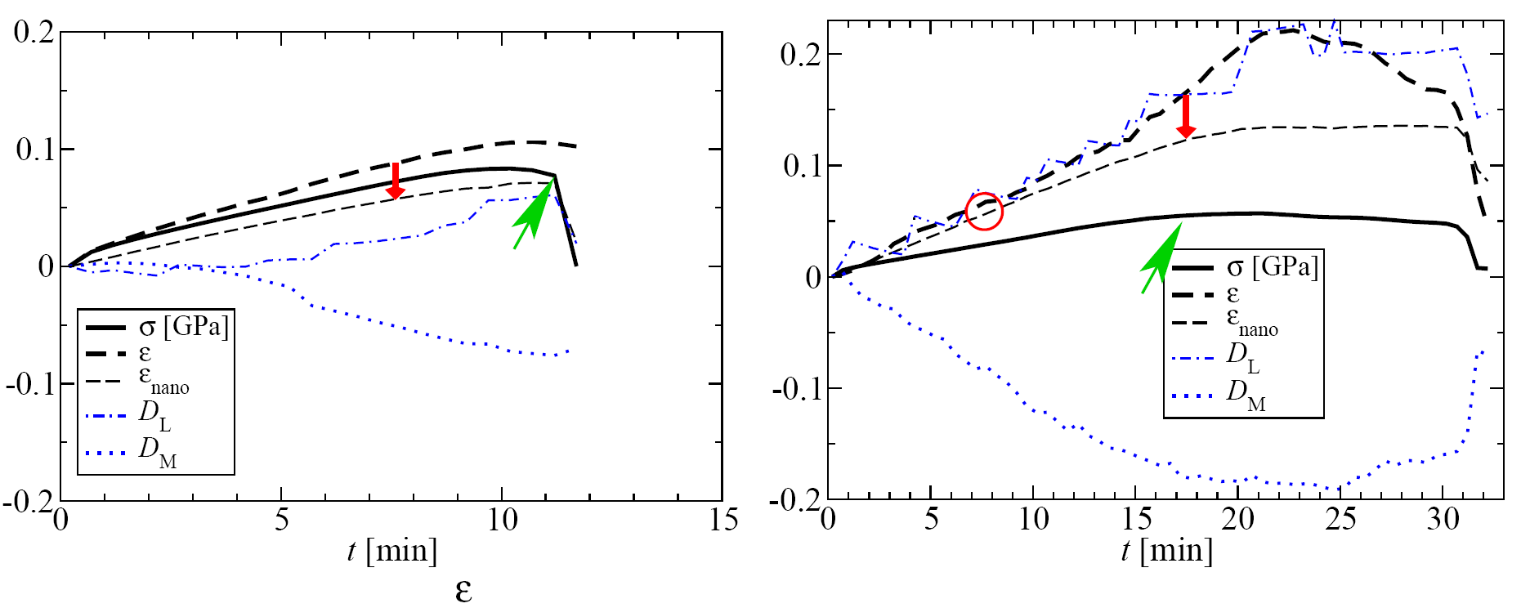
15
MFC Precursors Structure – HDPE/PA6
Cyclic strain in HDPE/PA6 MFC
HDPE
PA6
PE/PA6/YP=80/20/0
PE/PA6/YP=70/20/10

Slide 16
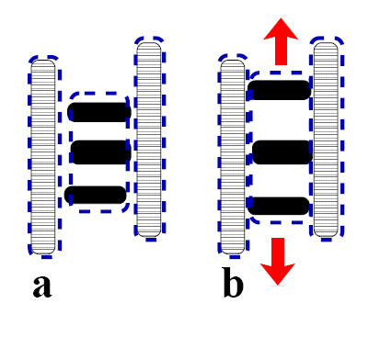
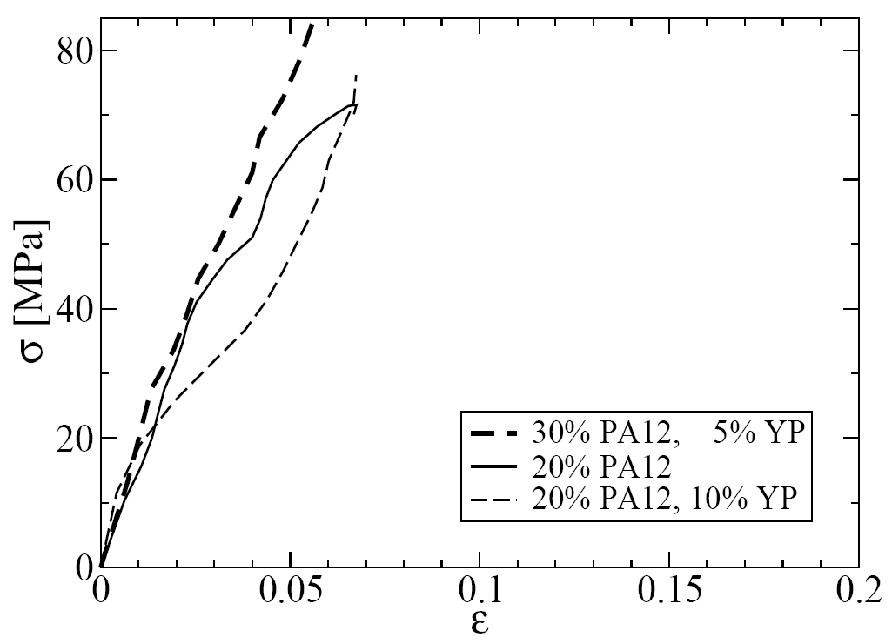
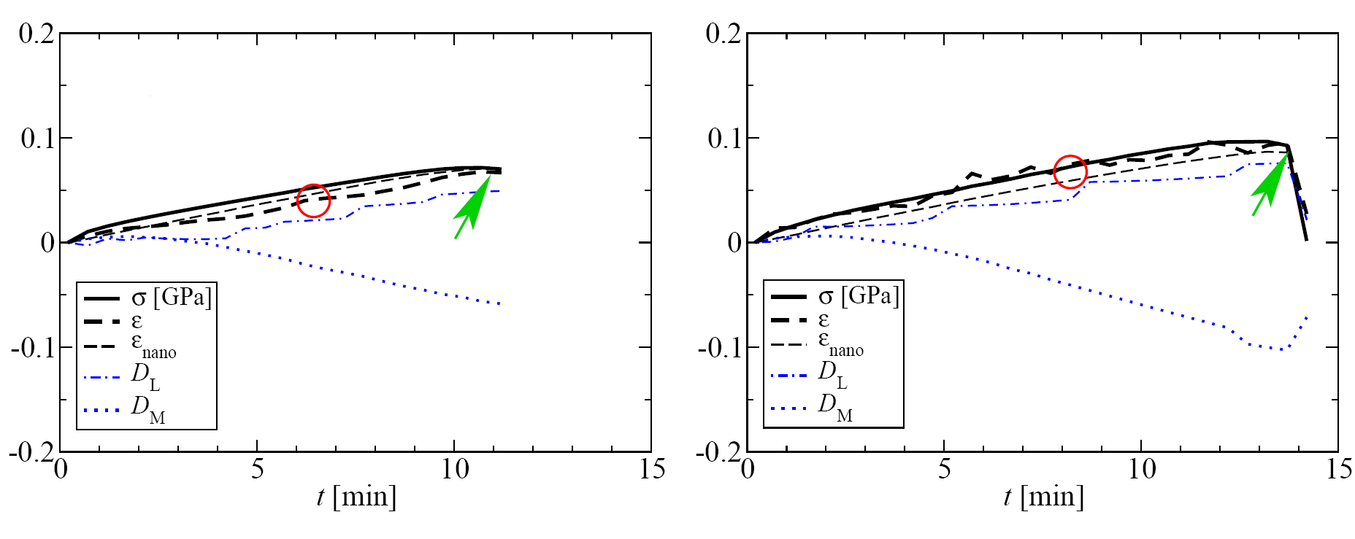
16
MFC Precursors Structure – HDPE/PA12
Cyclic strain in HDPE/PA12 MMT
HDPE
PA12
PE/PA12/YP=80/20/0
PE/PA12/YP=70/20/10

Slide 17
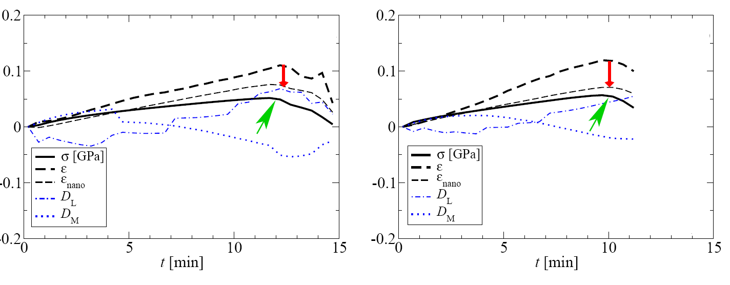
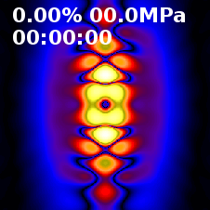
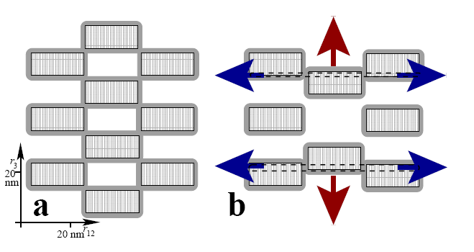
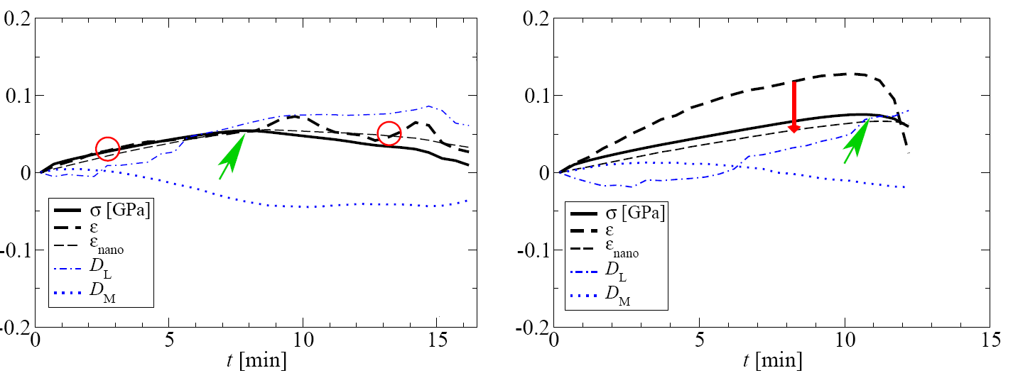
17
MFC Precursors Structure – HDPE/PA6-MMT
With nanoclay
+ Nanomer
+ Nanomer, + YP
Failure mechanisms with nanoclay
PE/PA6/0 =80/20/0 +7.5% MMT
+ Cloisite
+ Cloisite, + YP

Slide 18
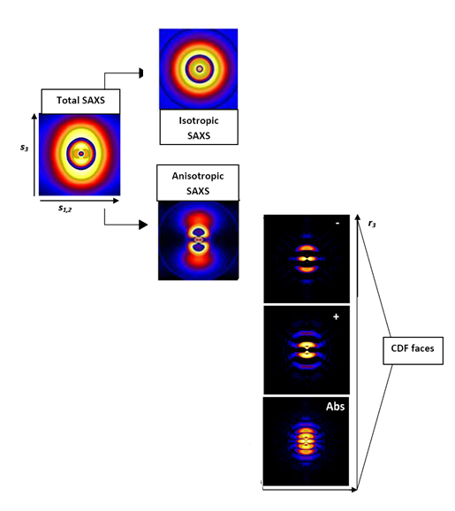





18
MFC Structure – HDPE/PA6
- CDF
+ CDF
MFC HDPE/PA6
Fibril (PA6)
TCL (HDPE)
30ºC
180ºC

Slide 19




19
MFC Structure – HDPE/PA6
MFC PE/PA6/YP = 80/20/0
MFC PE/PA6/YP = 70/20/10
Reversible strain-induced crystallization of matrix material

Slide 20

20
One-pot synthesis of PAMC
Starting mixture
Viscous particles
Microcapsules
Monomer
Catalytic system
Payload
Solvent
Multifaceted applications
CM, IM
Functionalization & Conjugation
Pay-loads used (1-10 wt.%):
Natural nanoclays, synthetic Al/Ti sillicates
Carbon allotropes – CB, CNT, CNF, GR, Fullerenes
Metal & Metal oxides – Cu, Al, Mg, Fe, Fe₃O₄
Hybrid composite materials
with electro-conductive & magnetic properties
Smart multifunctional
particle

Slide 21




22
Gradients of fillers by high-flux microfocus beam
P03 microfocus beamline

Slide 22


23
Gradients in PAMC by microfocus – PA6/@MMT
Y1; X 1
Y3; X 1-11
5/5μm
Scanning along X

Slide 23





24
Gradients in PAMC by microfocus – PA6/@MMT
x11
Scanning along Y
Y11; X1-10
y11
x01
Y10; X1-10
y01
Y09; X1-10
Y08; X1-10
Y07; X1-10

Slide 24





25
Gradients in PAMC by microfocus – PA6/@MMT
Distribution of non-exfolliated MMT
Thickness distribution of the PAMC layer
PAMC@Nanomer 2 wt%
Non-homogeneous exfoliation of MMT

Slide 25





26
Gradients in PAMC by microfocus – PA6/@MMT
Distribution of exfolliated MMT
Thickness distribution of the PAMC layer
PAMC@Cloisite 15A 2 wt%
Relatively homogeneous exfoliation of MMT

Slide 26




27
Gradients in PAMC by microfocus – PA6/@Al 5%
Thickness of PA6 layer
Intensity of the Al reflection
PAMC@Al 5 wt%
PA6-covered metal platelets

Slide 27




27
Gradients in PAMC by microfocus – PA6/@Fe₃O₄ 5%
Thickness of PA6 layer
Intensity of the Fe3O4 reflection
PAMC@Fe₃O₄ 5 wt%
PA6-covered metal platelets

